Slide 1
Migrating from Azure DevOps Releases to Multi-stage YAML
Richard Fennell Black Marble Chief Technology Officer, Microsoft MVP

Slide 2



A brief history of Microsoft DevOps build solutions…
No out the box build solution
Team Build
XAML Builds
Microsoft buy InCycle’s InRelease
Cross Platform Builds
Cross Platform
Release
YAML
Multi Stage YAML
2005
2008
2010
2013
2015
2017
2020

Slide 3
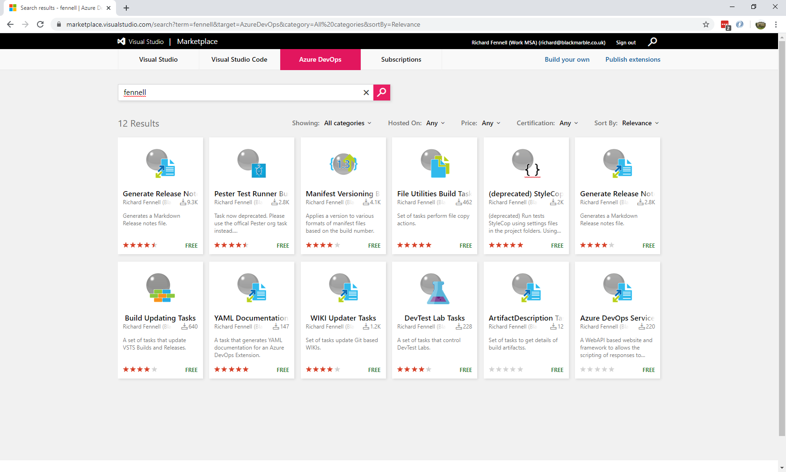

Slide 4
What DevOps process do I need?
Implement a new feature & commit to GitHub
Tell the world
Build, Run Unit Tests & Package
Publish Publicly & Update Docs
Publish Privately
Run Manual Tests
Run automated Tests

Slide 5
What Azure DevOps features might I use?
Previous - Build & Release
Going Forward - Multi Stage YAML
Build (Originally UI, then YAML)
Release
Task Groups
Variables & Variable Groups
Release Gate
Manual Approval
Multi Stage YAML
Multi Stage YAML
YAML Templates & Decorators
Variables & Variable Groups
Environment Checks & Approvals
Environment Checks & Approvals

Slide 6
Demo
Notes:
Have following open
Browser
Azure DevOps Marketplace
GitHub Azure
Pipelines Repo
Azure Function Repo
Azure DevOps Git Project
Pester Build (Old)
Xplat Build (YAML)
VS2019
Azure Function
VS Code
Pipelines Repo
Talk
Show marketplace
Looks at code in GitHub
Show Old way of working
Build
Triggers
Publish
Gates
Test
Public
New YAML
Walk through
Show templates
Variable Groups
Environments
Azure Function
Approval
Mention Dectorators
Discuss how to covert

Slide 7
Summary
Multi Stage YAML appears to be the future.
Some features are missing, but you can work around these limitations
Key advantage is the whole CI/CD process is under source control.
There is good reuse and enforcement via templates & decorators
Migration is ‘fiddly’ but not hard.
Recommend that you use Multistage YAML for new projects
…. and maybe for old, but don’t rush to swap if what you have works

Slide 8
Resources
Video of a shorter version of this session
Channel https://www.youtube.com/user/BlackMarbleLtd
Direct Link https://youtu.be/WMQ0G9eXczE
GitHub Repo
Azure DevOps Extensions https://github.com/rfennell/AzurePipelines
Azure Function Gate https://github.com/rfennell/AzureDevOpsExtensionGate
Presentation Slides https://github.com/rfennell/Presentations
Azure DevOps Team Project that hosts the Pipeline
https://dev.azure.com/richardfennell/GitHub

